Slide 1
TEAM 2
Tags (photos)-Vamshi

Slide 2
TABLE OF CONTENTS
Forget password
Profile picture
Create album
Tags (photos)
User profile & Privacy Settings

Slide 3
TAGS (PHOTOS)
A user may tag friends with his/her photos.
After tagging the photos will also be available on friends (tagged user) default album
Tables used from DB :
1. Images table

Slide 4
Continued..
Tables used from DB :
1. Images table
MVC Layout :
Controller – FriendRequestController
Service Layer – ICapbookService, CapbookService
DAO Layer – IFrriendDao

Slide 5
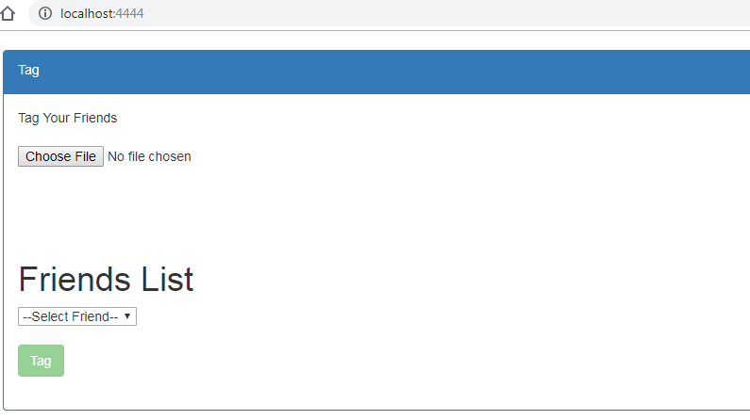
Tagging

Slide 6
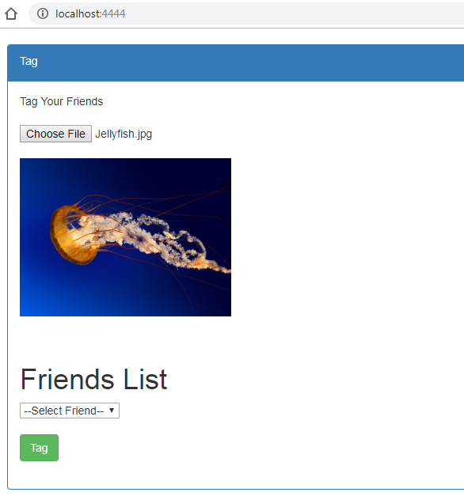

Slide 8
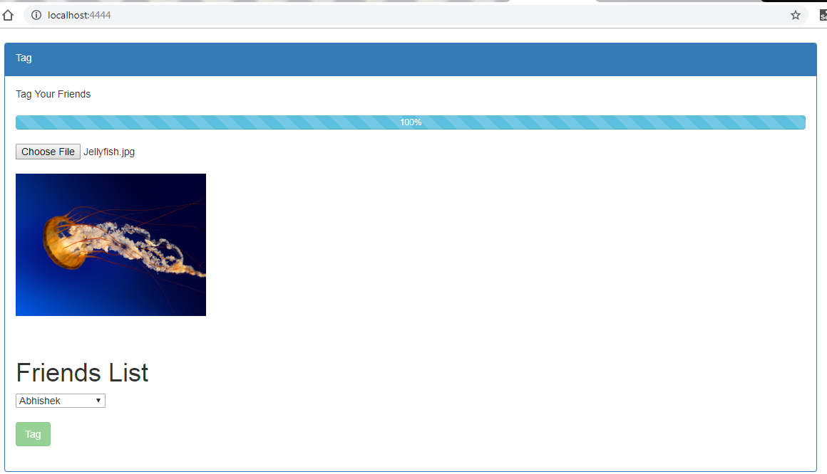

Slide 9
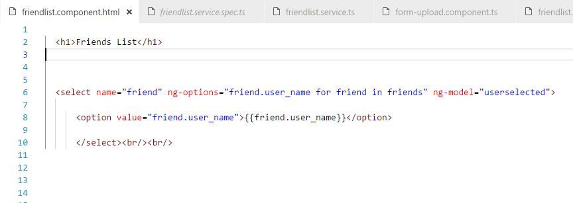

Slide 10
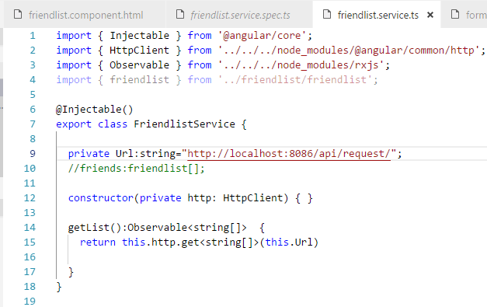

Slide 11
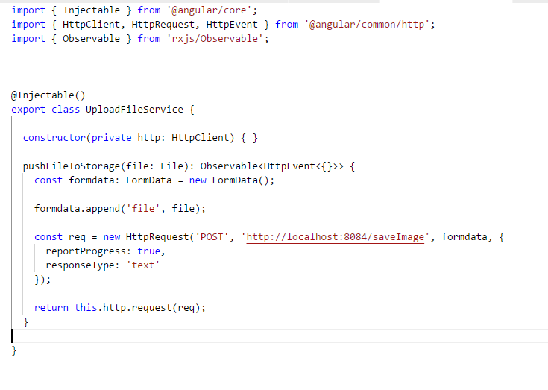

Slide 12
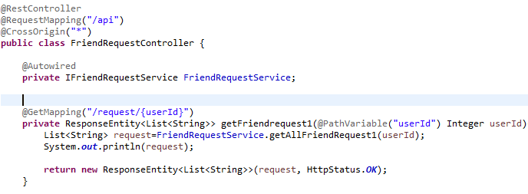

Slide 13
THANK YOU!!

